Slide 1
Weather patterns and storms
By: Professor Abdulaziz
(PhD in class jokes)

Slide 2
What are weather patterns?
A weather pattern is basically self explanatory. It is a series of repeating patterns that the weather has. Suddenly one day, the weather changes and for example dry weather for 2 weeks becomes rainy weather for a week. When this happens it is referred to as a weather pattern change.

Slide 3
Global Winds
Global winds are self explanatory too, they are winds on a global basis. When the sun heats the earth and the night side of earth (the side that is not facing the Earth) is cooling, the heat is not equal globally. Since the cooler air is sinking and the hotter goes up, they have to move. They also misplace some air stuck in the middle, causing winds. These winds are to travel thousands of kilometers.

Slide 4
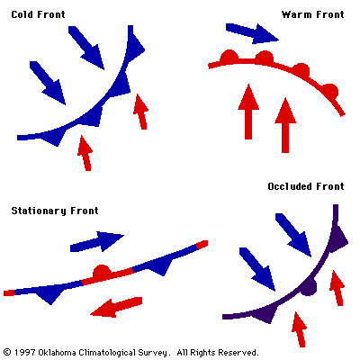
Fronts
The location where two air masses meet is called a front. They can be indirectly observed using current weather maps, which can be used to track them as the move across the Earth. Cold fronts, generally shown in blue, occur where a cold air mass is replacing a warm air mass. Warm fronts, shown in red, occur where warm air replaces cold air.

Slide 5
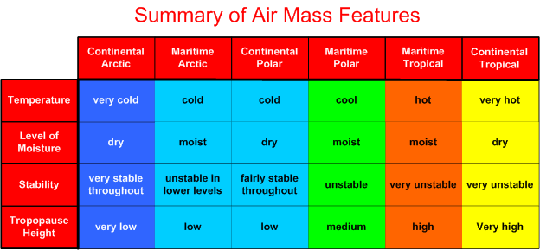
Air Masses
These global wind patterns drive large bodies of air called air masses. Each of these large bodies of air extends across large areas of the Earth and is thousands of feet thick. The location over which an air mass forms will determine its characteristics. For example, air over the tropical ocean becomes hot and humid. Air over a high latitude continent may become cold and dry.

Slide 6
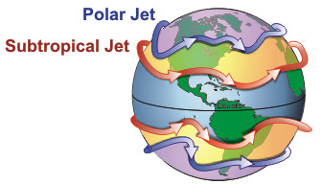
Jet streams
The local weather conditions that we experience at the Earth's surface are related to these air masses and fronts.
But the environment far above us affects their movement. High in the atmosphere, narrow bands of strong wind, such as the jet streams, control weather systems and transfer heat and moisture around the globe.
‘’

Slide 7
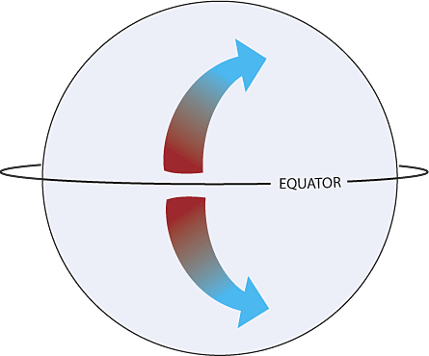
Coriolis Effect
This is the effect that occurs on global winds when the earth rotates. Think of it are you trying to walk straight on a 1km slowly spinning disc. You will end up off path by a lot of degrees.

Slide 8
Desert Climate (Kuwait)
Located in the desert geographical region, Kuwait has a climate characterized by its dry, hot and long summer. It also has a short warm winter with occasional rain. Dust storms often occur during the summer months. The relative humidity increases and temperature sometimes reaches 50 °C under shadow.

Slide 9
Temperate Climate
Temperate climate is your typical climate in Europe and middle North America. It involves warm, average length summers, and long cold winters. Rainfall is common and is very heavy.

Slide 10
Tundra Climate
Tundra climates are dry like deserts, and have little to no trees (It does have plants though) It is quite cold and snowy most of the year. It has long, cold, harsh winters.

Slide 11
Subarctic Climate
Subarctic climate is the harshest climate where humans can live, considering that plants basically can’t live and its winter 10 months of the year. Temperatures can go as low as -40 Celsius. It’s the polar opposite of Kuwait's weather.

Slide 12
Tropical Climate
Tropical climates are located near the equator. They do not have any seasons but have seasonal monsoons. They are rainy 6 months and dry the other 6. Tropical areas have the most precipitation year round.

Slide 13
Storms
There are times when disturbances occur to weather and extreme conditions happen. Those times are called storms.

Slide 14
Types of storms.
Ice storms.
Blizzard
Snowstorm
Hailstorm
Fire storm
Dust Devil
Gale
Cyclones
Tornados

Slide 15
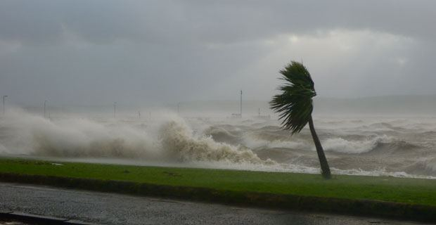
Gale
A gale is a strong blowing wind. But not all strong winds are defined as gales. The wind speed must go over 60 MPH (94 KPH) to be considered a gale.

Slide 16
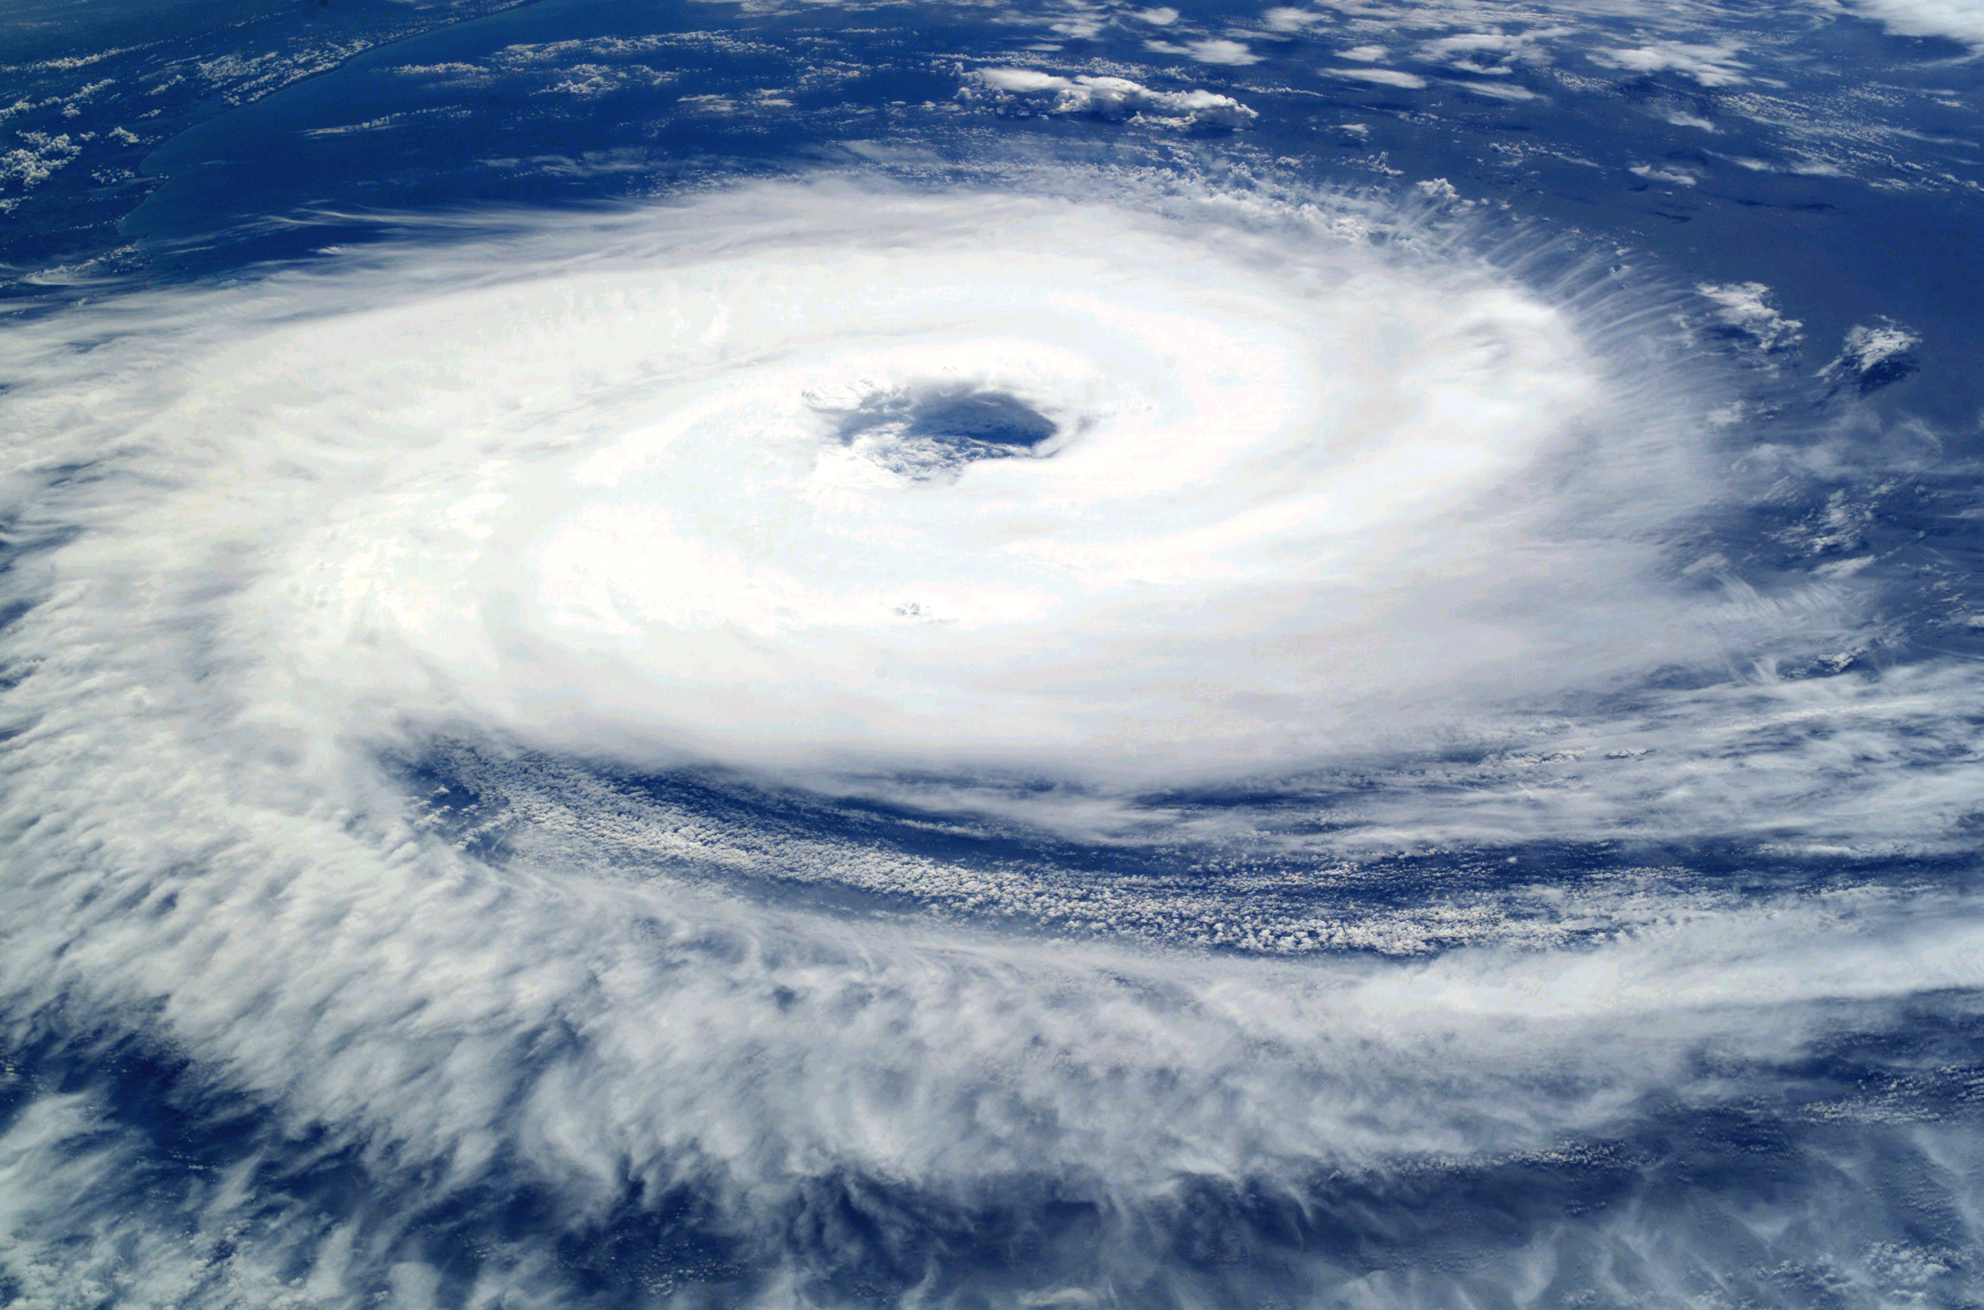
Cyclones
A cyclone is a large-scale, atmospheric wind-and-pressure system characterized by low pressure at its center and by circular wind motion, counterclockwise in the Northern Hemisphere, clockwise in the Southern Hemisphere.

Slide 17
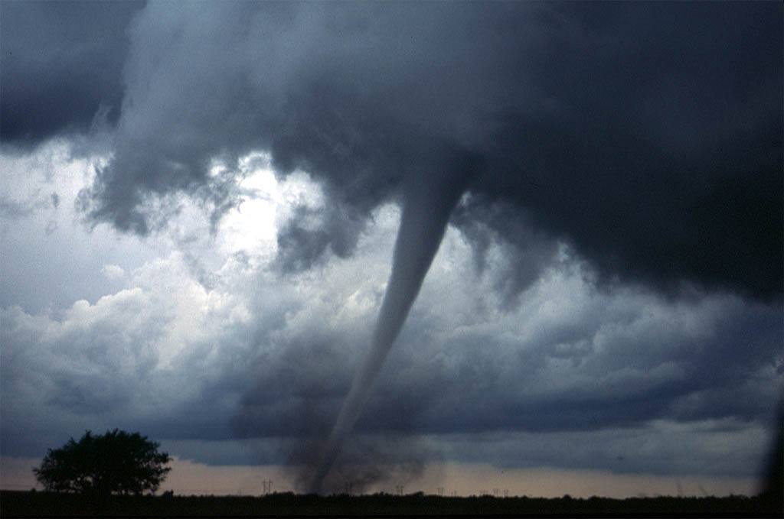
Tornados
A tornado is very similar to a cyclone, with the only difference being that it is formed with a culumlonibus cloud above it. a tornado only travels a few kilometers, but causes huge damage to anything in its path.

Slide 18
*MOST DANGEROUS STORM*
THIS IS THE MOST RARE, THE MOST MLG STORM THE WORLD HAS EVER SEEN. IT IS THE DARUDE SANDSTORM. IT IS FORMED WHEN MOUTAIN DEW ENRICHED DORITOS DUST IS BLOWN BY A STONG GALE.
THE FOLLOWING STORM IS CALLED A DARUDE SANDSTROM. IT IS HIGHLY DANGEROUS, AS DOGS GO FERAL AND A GUY CHASES A WOMAN WITH A SUITCASE WHEN THIS HAPPENS. YOU CAN ALSO HEAR SOME WUBS IN THE AIR.

Slide 19
Thank you for listening

