Slide 1
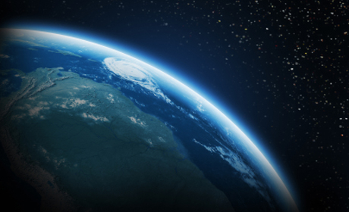
THE ATMOSHPHERE
Lesson 1.1 and 1.2
Made by :
Abdullah Al Hamer
Khalid Al Dayhani
Ahmed Ra’id Al Shatti
Barrack Al Ammar

Slide 2
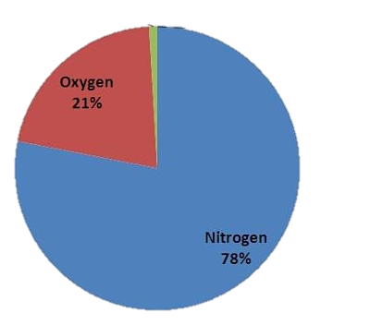
So…What is the Atmosphere?
The atmosphere is a thin layer of air that surrounds the Earth.
The atmosphere is made up of four layers.
The layer we live in is called the troposphere.
The atmosphere is about 78% nitrogen, 21% oxygen gas, and the other one percent of the atmosphere are a bunch of other gases like argon or carbon dioxide.
Argon & other gases are 1%.

Slide 3
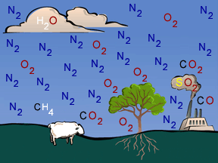
The Earth’s Atmosphere Supports Life
The atmosphere contains oxygen in which we breath in.
The thickness of air is measured by density.
The atmosphere protects Earth from harmful radiation.
Radiation is energy that travels across distances from certain types of waves. Most of the energy and radiation comes from the sun.

Slide 4
The Earth’s Atmosphere Supports Life (2)
The atmosphere's density decreases as you travel upward, causing lack of air. Though it is not the only characteristic that changes with altitude, different parts of the atmosphere absorb and move in different ways.
Altitude is a term used to signify the distance above sea level.
There are events that cause change in the atmosphere like: volcanic eruptions, forest fires, and dust storms.

Slide 5
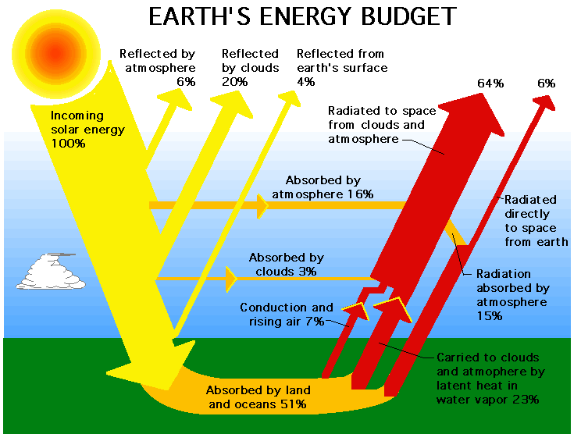
The Sun’s energy in the Atmosphere
Heated gas or liquid carries energy as it moves.
The following picture provides an explanation for what happens to the sun’s radiation.
To sum it up, about 50 % is absorbed by the Earth and the Ocean. About 25 % is reflected by the clouds and Earth’s atmosphere. About 5 % is reflected by the Earth’s surface. Last but not least, About 20% is absorbed by clouds and Earth’s atmosphere.

Slide 6
Energy Movement
There are three types of energy movement:
- Radiation
- Conduction
- Convection
Radiation, also, transfers energy from sand to air. The energy from radiation warms the air.
Conduction is the transfer of heat energy from one substance to another by direct contact.
Convection is the transfer of energy from place to place by motion of gas or liquid, as stated before.

Slide 7
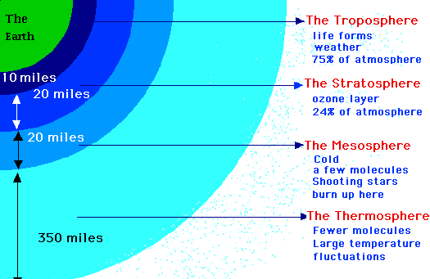
The Atmosphere’s layers

Slide 8
Review
1-
What are the three types of energy transfer?
2-
What are the four layers of the atmosphere from closest to sea level to farthest.?
3-
Where does most of the energy come from?

Slide 9
Review
1-
What are the three types of energy transfer?
Radiation, conduction, and convection.
2-
What are the four layers of the atmosphere from closest to sea level to farthest.?
Troposphere, stratosphere, mesosphere, and thermosphere.
3-
Where does most of the energy come from?
The sun.

