Slide 1
Lesson 2.1 & 2.2
8-1

Slide 2
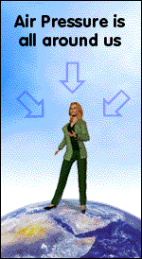
Air pressure
Air pressure is the force of air molecules pushing on an area.
The greater the force , the higher the air pressure.
Because air molecules move in all directions , air pressure pushes in all directions.

Slide 3
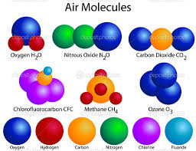
Air molecules
The smallest physical unit of an element or compound, consisting of one or more like atoms in an element and two or more different atoms in a compound.
Air molecules move constantly.
As they move they bounce off each other like rubber balls. They also bounce off every surface they hit.
Each time an air molecule bounces off an object , it pushes or exerts a force , on that object.

Slide 4
Density
Density is the amount of mass in a given volume of a substance.

Slide 5
Air pressure and density
Above each location on earth is a column of air that stretches to the top of the atmosphere.
Air pressure and density are higher at sea level because a taller column of air pushes down.
Air pressure and density are lower at a high altitude because a shorter column of air pushes down.

Slide 6
Air pressure
The air pressure at any area on Earth depends on the weight of the air above that area. If you hold out your hand, the force of air pushing down on your hand is greater than the weight of a bowling ball. So why don’t you feel the air pushing down on your hand ? Remember that air pushes in all directions . The pressure of air pushing down is balanced by the pressure of air pushing up from below.

Slide 7
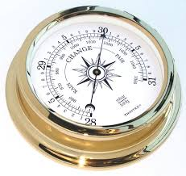
Barometer
Barometer is any instrument that measures air pressure.

Slide 8
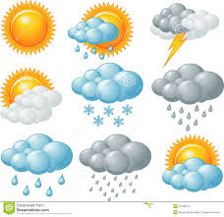
Weather
Weather is the condition of earth atmospere at a particular time and place.

Slide 9
Monsoons
Winds that change direction with the seasons.
Monsoons are caused by the different heating and cooling rates of land and sea .
However , monsoons flow longer distances and affect much larger areas.
Winter monsoons occur in regions where the land becomes much cooler than the sea during winter. High pressure builds over a land, and cool, dry wind blows out towards the sea. During summer this pattern reverses as the land becomes much warmer than the sea.

Slide 10
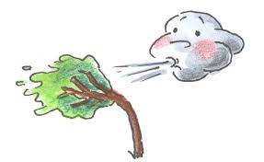
Wind
Wind is air that moves horizontally or parallel to the ground.

Slide 11
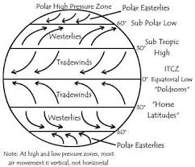
Global wind
Global wind travel thousands of kilometers in steady patterns.

Slide 12
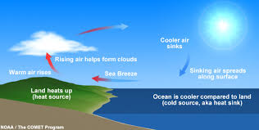
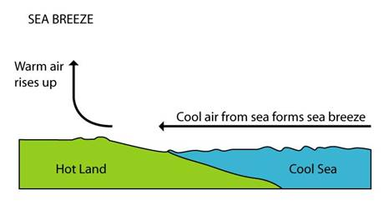
Local Winds
Some winds change daily in a regular pattern. These local winds blow within small areas.
Sea breezes and land breezes occur near shorelines. During the day, land heats up faster than water. The air over the land rises and expands . Denser ocean air moves into the area of low pressure, producing a sea breeze. As the illustration below shows, this pattern is reversed at night , when land cools faster than water. Warm air rises over the ocean , and cooler air flows in, producing a land breeze.

Slide 13
Valley and mountains breezes
Valley breezes and mountain breezes are caused by a similar process. Mountain slopes heat up and cool faster than the valleys below them. During the day , valley breezes flow up mountains . At night mountain breezes flow down into valleys.

Slide 14
Important Vocabulary
Air Pressure
Barometer
Easterlies
Westerlies
Jet Streams
Coriolis Effect
Horse Latitudes
Trade Winds

